Slide 1
The Control Plane & Programmatic Interfaces

Slide 2
Learning Outcomes
LO 3 : Application: Apply programmatic interfaces and control plane automation tools to provision, configure, and manage the lifecycle of virtualized resources. LO 3 : Analyze system requirements to identify actors, processes, data, and interactions
LO 4 : Apply UML-based design artifacts to communicate a complete system solution

Slide 3
Outline
Interfacing with the hypervisor via APIs
Resource agents
The role of libvirt and virsh
Cloud management orchestration layers

Slide 4
Interfacing with the hypervisor via APIs

Slide 5
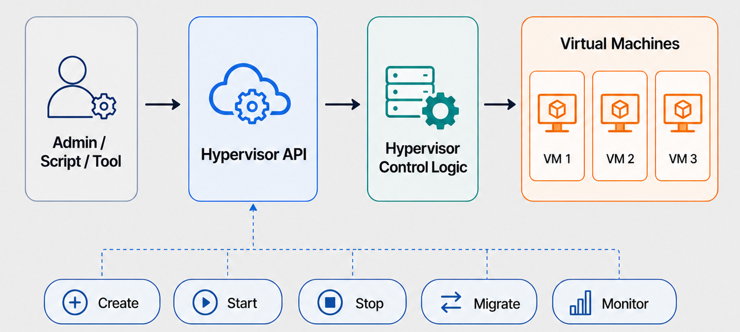
Interfacing with the hypervisor via APIs
Hypervisors API Definition
Programmatic interface to control the hypervisor
Allows external tools to manage virtual machines
Common operations: create, start, stop, migrate, monitor
Enables automation beyond manual administration
Notes:
A hypervisor API provides a programmatic way to control virtualization infrastructure. Instead of using only a graphical interface, administrators and automation tools can send structured commands to create, start, stop, migrate, and monitor virtual machines.

Slide 6
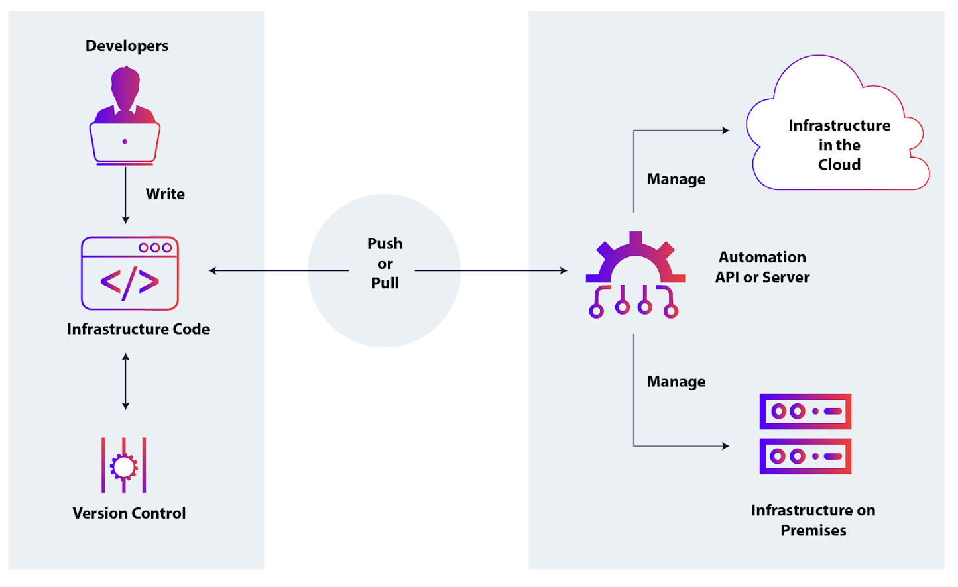
Interfacing with the hypervisor via APIs
Why is it matter?
Automation at scale
Consistent VM lifecycle management
Integration with monitoring and orchestration tools
Foundation for cloud self-service portals
Reduces manual operational work
Image retreived from https://www.appviewx.com/education-center/hypervisor/
Notes:
APIs are important because cloud infrastructure must operate at scale. A cloud platform may need to create hundreds or thousands of virtual machines consistently. APIs allow higher-level systems to automate these tasks and integrate virtualization with monitoring, scheduling, and orchestration workflows.

Slide 7
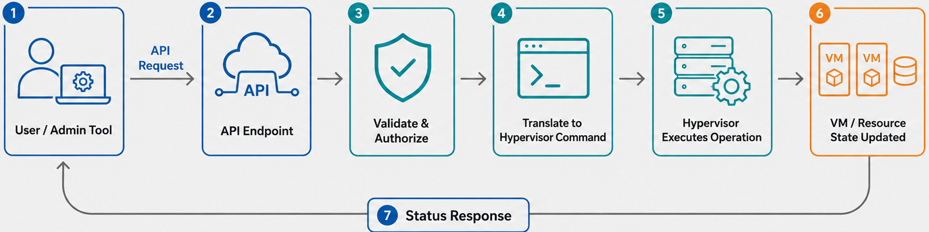
Interfacing with the hypervisor via APIs
Hypervisor API Request Flow
Notes:
APIs are important because cloud infrastructure must operate at scale. A cloud platform may need to create hundreds or thousands of virtual machines consistently. APIs allow higher-level systems to automate these tasks and integrate virtualization with monitoring, scheduling, and orchestration workflows.

Slide 8
Resource agents

Slide 9
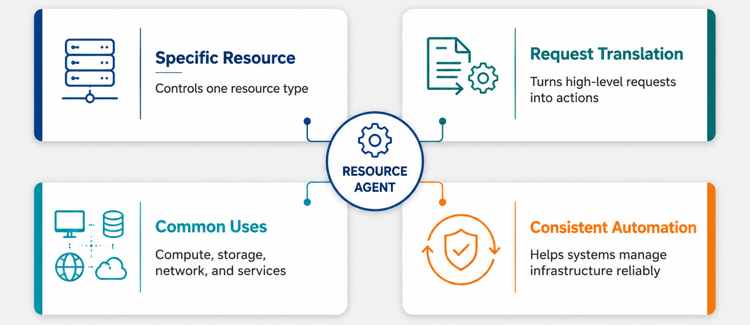
Resource agents
Definition
Notes:
A resource agent is a software component that manages a specific infrastructure resource. It acts as the executor between the control plane and the actual resource. For example, when the control plane asks to start a virtual machine, attach storage, or configure networking, the resource agent translates that request into the correct operational steps. This makes infrastructure management more consistent, because different resources can be controlled through a predictable automation layer.

Slide 10
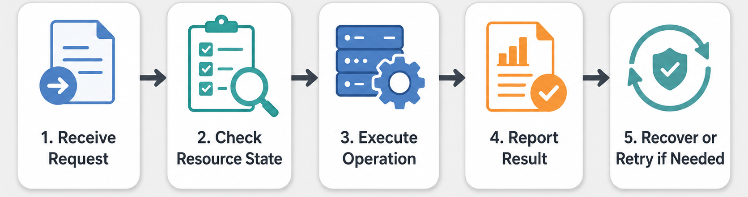
Resource agents
How Resource Agents work
Notes:
Resource agents usually follow a simple operational flow. First, they receive a request from an administrator, script, or orchestration system. Then, they check the current state of the target resource to avoid unnecessary or unsafe actions. After that, they execute the required operation, such as starting a VM, attaching a volume, or applying a network configuration. Finally, they report the result back to the control plane. If something fails, the agent may retry, recover, or return an error for further handling.

Slide 11
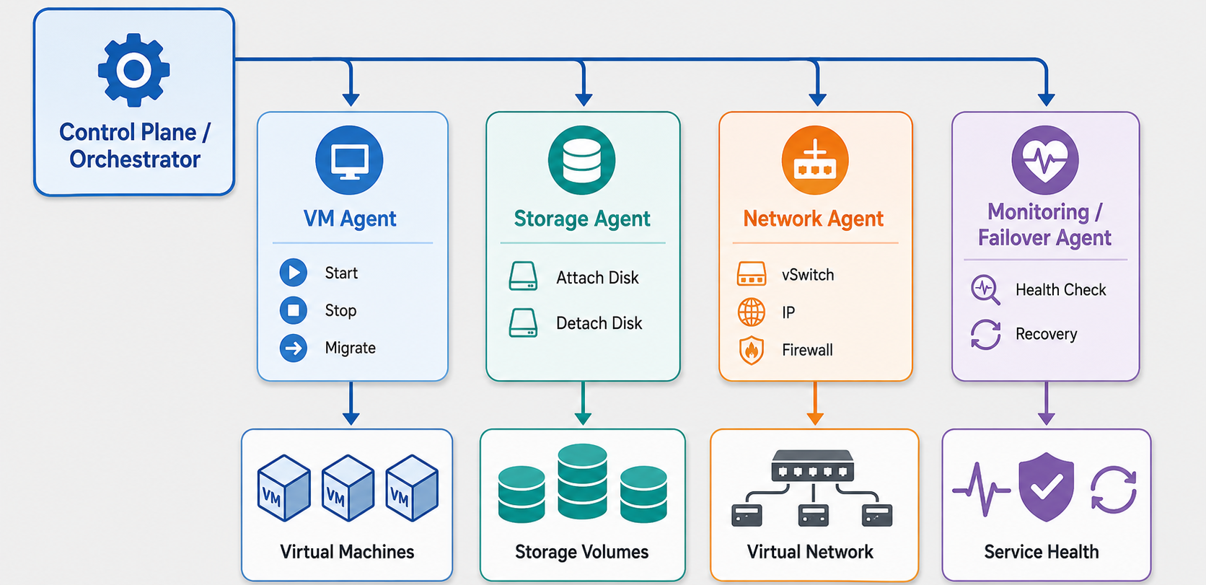
Resource agents
Resource Agents in Virtualized
Notes:
Resource agents usually follow a simple operational flow. First, they receive a request from an administrator, script, or orchestration system. Then, they check the current state of the target resource to avoid unnecessary or unsafe actions. After that, they execute the required operation, such as starting a VM, attaching a volume, or applying a network configuration. Finally, they report the result back to the control plane. If something fails, the agent may retry, recover, or return an error for further handling.

Slide 12
The role of libvirt and virsh

Slide 13
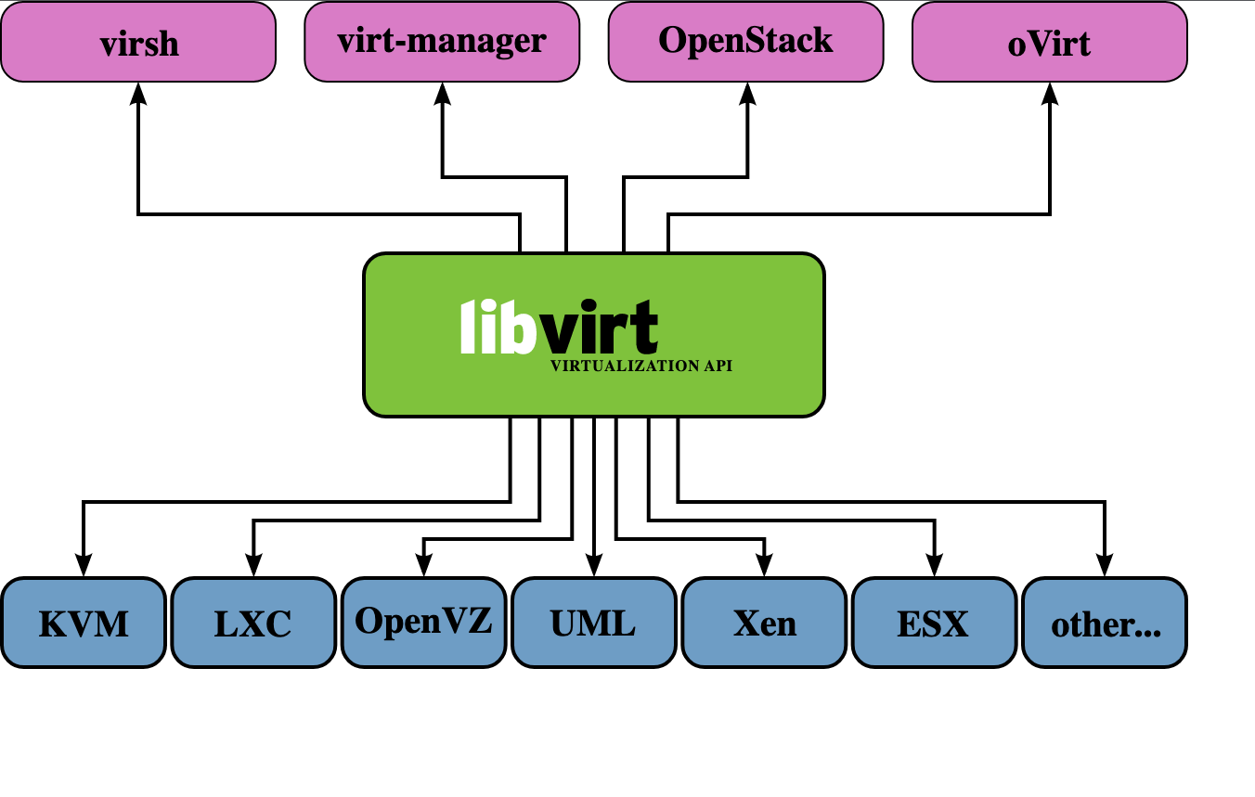
The role of libvirt and virsh
LibVirt Overview
Open-source virtualization management toolkit
Provides a common API for multiple hypervisors
Manages VMs, storage, and virtual networks
Used by tools, scripts, and orchestration platforms
Reduces hypervisor-specific management complexity
Image retreived from https://www.sobyte.net/post/2022-05/libvirt/
Notes:
Libvirt is an open-source virtualization management toolkit that provides a common interface for multiple hypervisors. Instead of interacting directly with each platform using different commands, tools and administrators can use libvirt as a unifying management layer. This makes it easier to manage virtual machines, networks, and storage resources consistently across different virtualization environments.

Slide 14
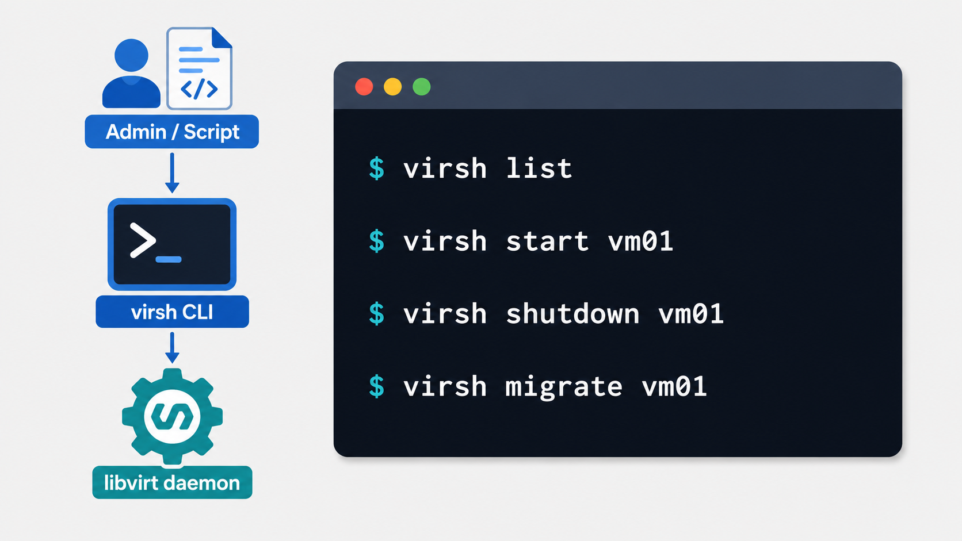
The role of libvirt and virsh
VIrsh Overview
Command-line interface for libvirt
Used to manage virtual machine lifecycle
Supports start, shutdown, pause, define, and migrate
Useful for administration and automation scripts
Works as a practical interface to libvirt-managed hosts
Notes:
Virsh is the command-line tool commonly used to interact with libvirt. Administrators can use it to list running virtual machines, start or stop a guest, inspect configuration, or trigger migration. Although virsh looks like a simple command-line utility, it is actually sending management requests through libvirt, which then communicates with the appropriate hypervisor backend.

Slide 15
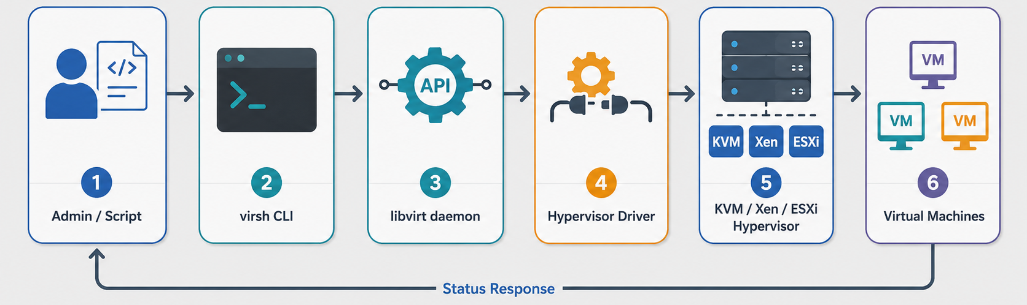
Resource agents
Resource Agents in Virtualized
Notes:
The workflow starts when an administrator or automation script sends a virsh command. Virsh passes the request to libvirt, and libvirt uses the appropriate driver for the target hypervisor. The hypervisor then performs the requested operation, such as starting a virtual machine or changing its state. After the operation is executed, the updated status is returned so the administrator or higher-level control plane can track the result.

Slide 16
Cloud management orchestration layers

Slide 17
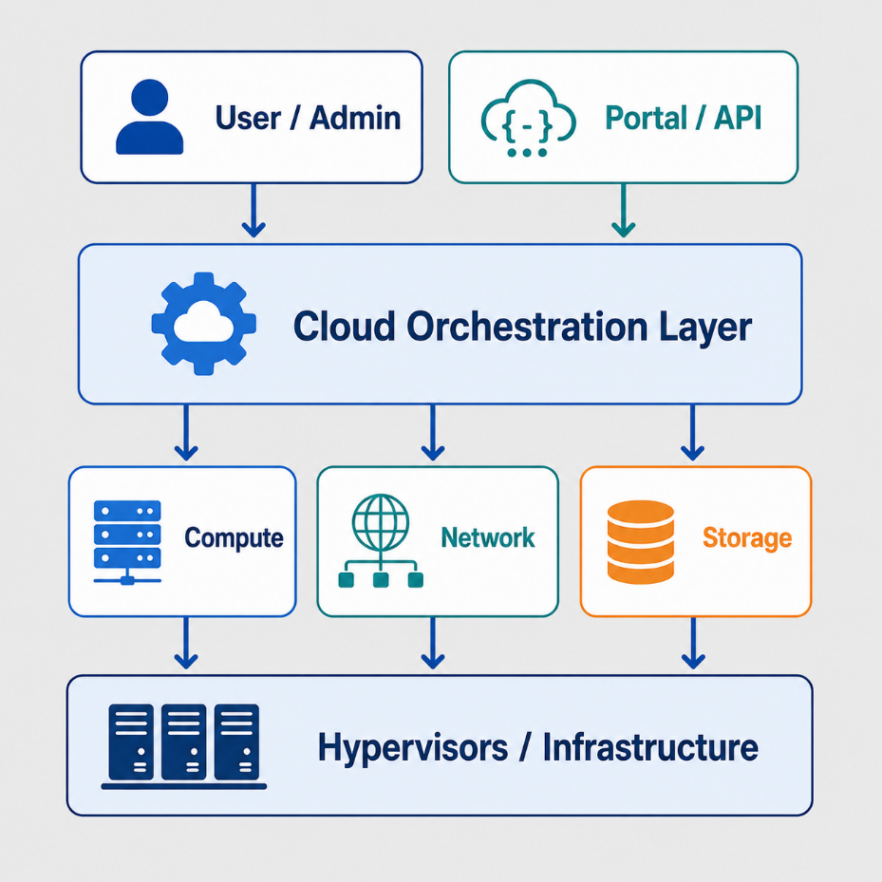
Cloud management orchestration layers
CLOUD ORCHESTRATION LAYER
Coordinates infrastructure operations across systems
Connects users, APIs, policies, and resource managers
Automates VM, network, storage, and service provisioning
Maintains desired infrastructure state
Acts as the control layer above individual hypervisors
Notes:
A cloud orchestration layer coordinates infrastructure operations across multiple systems. Instead of managing each hypervisor, network, or storage component manually, the orchestration layer receives user or API requests and translates them into coordinated infrastructure actions. This layer is important because cloud platforms need to manage resources as a complete system, not as isolated machines.

Slide 18
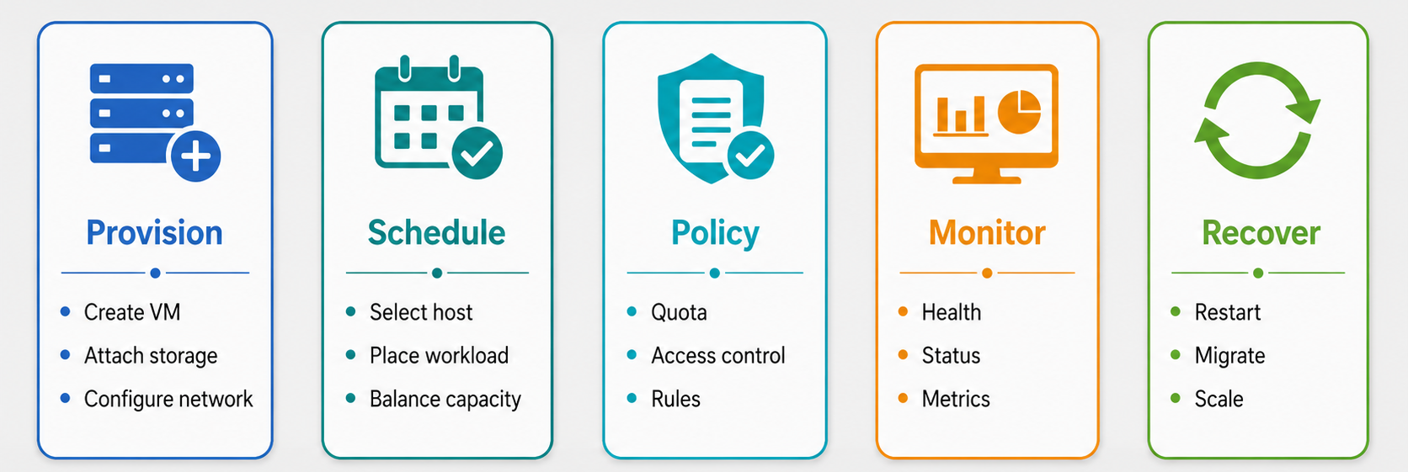
Cloud management orchestration layers
Responsibilities of Orchestration Layers
Notes:
The orchestration layer is responsible for more than simply starting virtual machines. It decides where workloads should run, applies policy rules, checks the current state of infrastructure, and triggers recovery when something fails. In a cloud environment, orchestration allows infrastructure to behave more like a managed platform rather than a collection of manually configured servers.

Slide 19
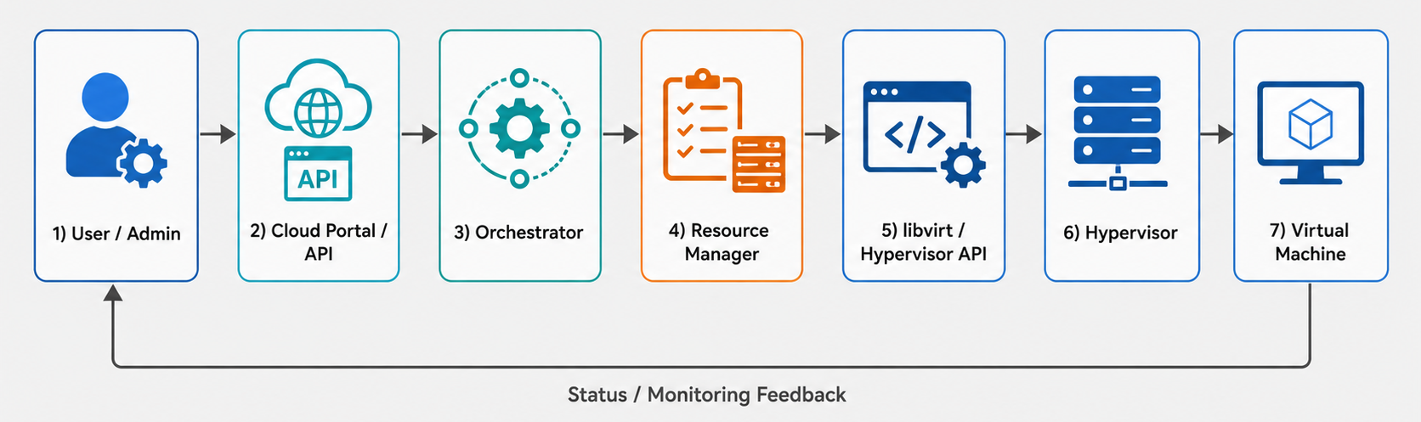
Cloud management orchestration layers
Example Architecture: User Request to VM Provisioning
Notes:
This example shows how a user request becomes an infrastructure operation. The user does not directly communicate with the hypervisor. Instead, the request goes through a portal or API, then the orchestrator checks policy, quota, and resource availability. After that, the resource manager coordinates compute, network, and storage resources before the hypervisor creates the virtual machine. The result is then reported back to the user or the control plane.

Slide 20
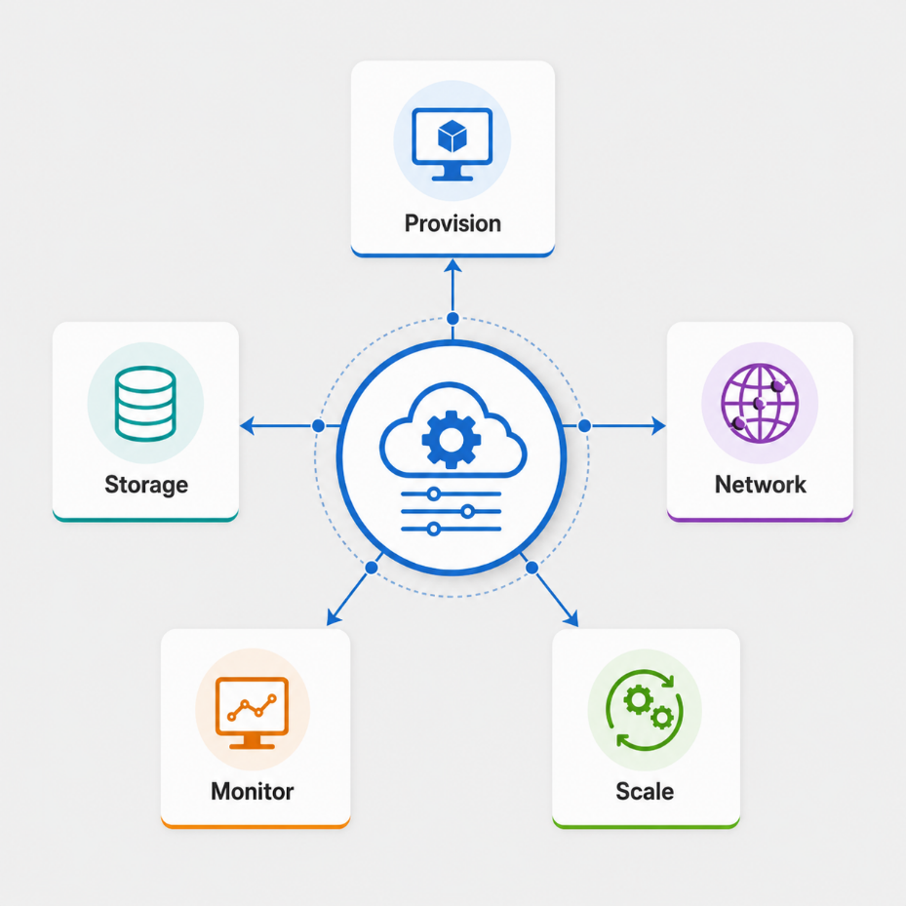
Cloud management orchestration layers
Why this is matter
Hides low-level infrastructure complexity
Enables self-service cloud operations
Improves consistency across environments
Supports automation, scaling, and recovery
Connects virtualization to cloud-native platforms
Notes:
Orchestration layers matter because they hide infrastructure complexity from users and developers. A user may only request a virtual machine or application environment, but behind the scenes the platform must allocate compute, configure networking, attach storage, enforce policy, and monitor the result. This is what makes cloud infrastructure scalable, repeatable, and suitable for cloud-native application deployment.

Slide 21
Exercise
Control Plane vs. Data Plane Isolation
Modern cloud infrastructure relies heavily on automated scripts and orchestration engines interacting with a hypervisor's management API to provision, migrate, and delete virtual machines.
Question: From a security and performance standpoint, why is the hypervisor's management API channel strictly isolated (often on a dedicated VLAN or internal network interface) from the standard network traffic of the guest VMs?

Slide 22
References
Erl, T., & Barceló Monroy, E. (2024). Cloud computing: Concepts, technology, security, and architecture (2nd ed.). Pearson.
Katzer, J. (2020). Learning serverless: Design, develop, and deploy with confidence. O’Reilly Media.
Marinescu, D. C. (2022). Cloud computing: Theory and practice (3rd ed.). Elsevier.
The libvirt Project. (n.d.). virsh: Management user interface. Retrieved June 21, 2026, from https://www.libvirt.org/manpages/virsh.html
Notes:
Orchestration layers matter because they hide infrastructure complexity from users and developers. A user may only request a virtual machine or application environment, but behind the scenes the platform must allocate compute, configure networking, attach storage, enforce policy, and monitor the result. This is what makes cloud infrastructure scalable, repeatable, and suitable for cloud-native application deployment.

